Slide 1


Hotel Reservation Analysis
SQL
MENTORNESS
MIP-DA-04 Batch
By: Allan Cheerakunnil Alex

Slide 2

Introduction
Data Collection
ER Diagram
Questions
Source Code using PostgreSQL
Interpretation of Results
Recommendations
Thank You
Data Management in SQL
Agenda

Slide 3

Introduction
Objective: This presentation aims to delve into the details of hotel reservation data analysis. By dissecting trends and guest behaviors, as I seek to unlock actionable insights that can propel the hotel’s strategic initiatives forward.
Scope: I have gone through the dataset and it enabled me to search for the query which was provided by finding its answer.

Slide 4

Data Collection
Acquisition: The foundation of my analysis is built upon a dataset meticulously sourced from a publicly accessible dataset provided by MentorNess in the format of CSV file on Google Drive, ensuring transparency and reproducibility of my findings.
Selection Criteria: The dataset was chosen for its comprehensiveness and relevance, providing a robust platform for an in-depth examination of reservation patterns and guest preferences.

Slide 5

Data Management in SQL
Database Environment: Utilizing PostgreSQL 16 and the intuitive interface of pgAdmin4, I imported the prepared dataset into a structured SQL environment.
Schema Design: I crafted a schema that mirrors the complexities of hotel operations, encompassing tables for reservations, market segments, distribution channels, and meals, complete with relational integrity through primary and foreign keys.
Data Transformation: The SQL queries not only organized the data but also transformed it into a CSV file within PostgreSQL.

Slide 6
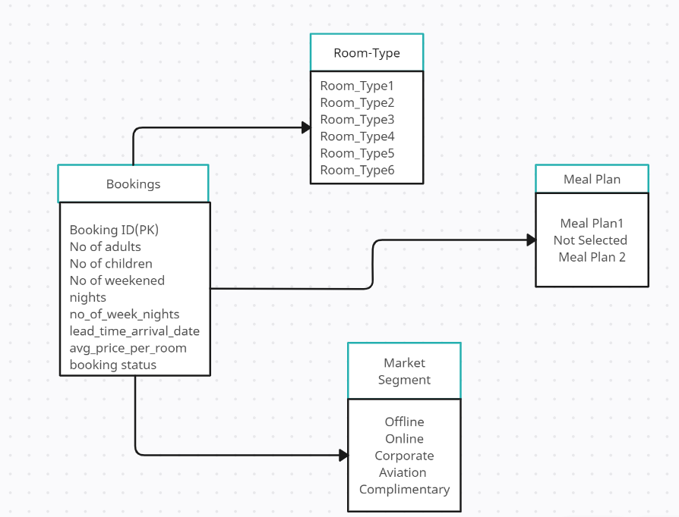
ER Diagram

Slide 7
Questions
How many reservations are there in the hotel_data_analysis?
What is the most commonly chosen meal plan type in the hotel_data_analysis dataset?
What is the most frequently reserved room type in the hotel_data_analysis dataset?
How many reservations where made in the year 2018 according to the hotel_data_analysis dataset?

Slide 8
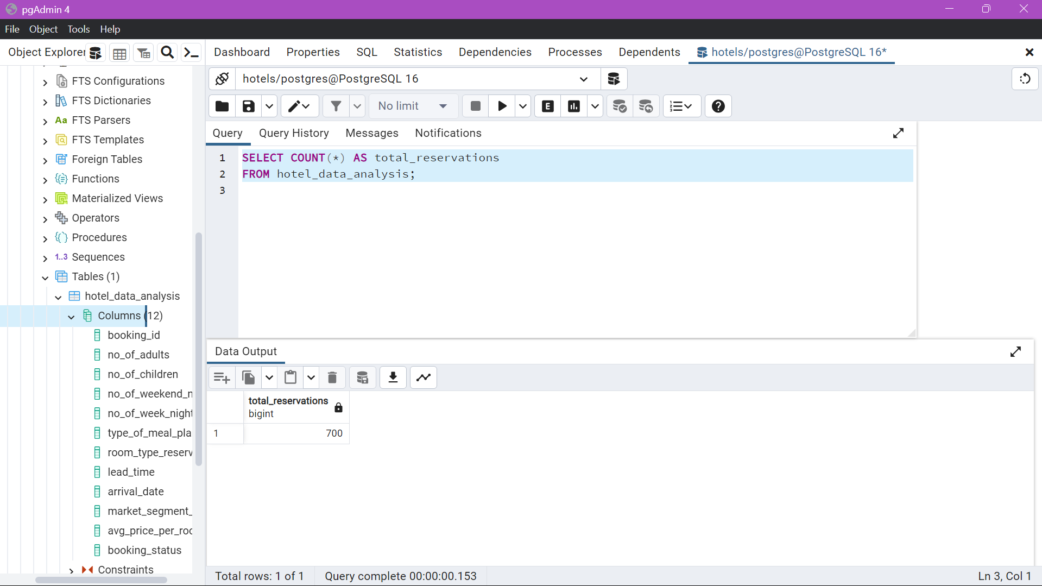
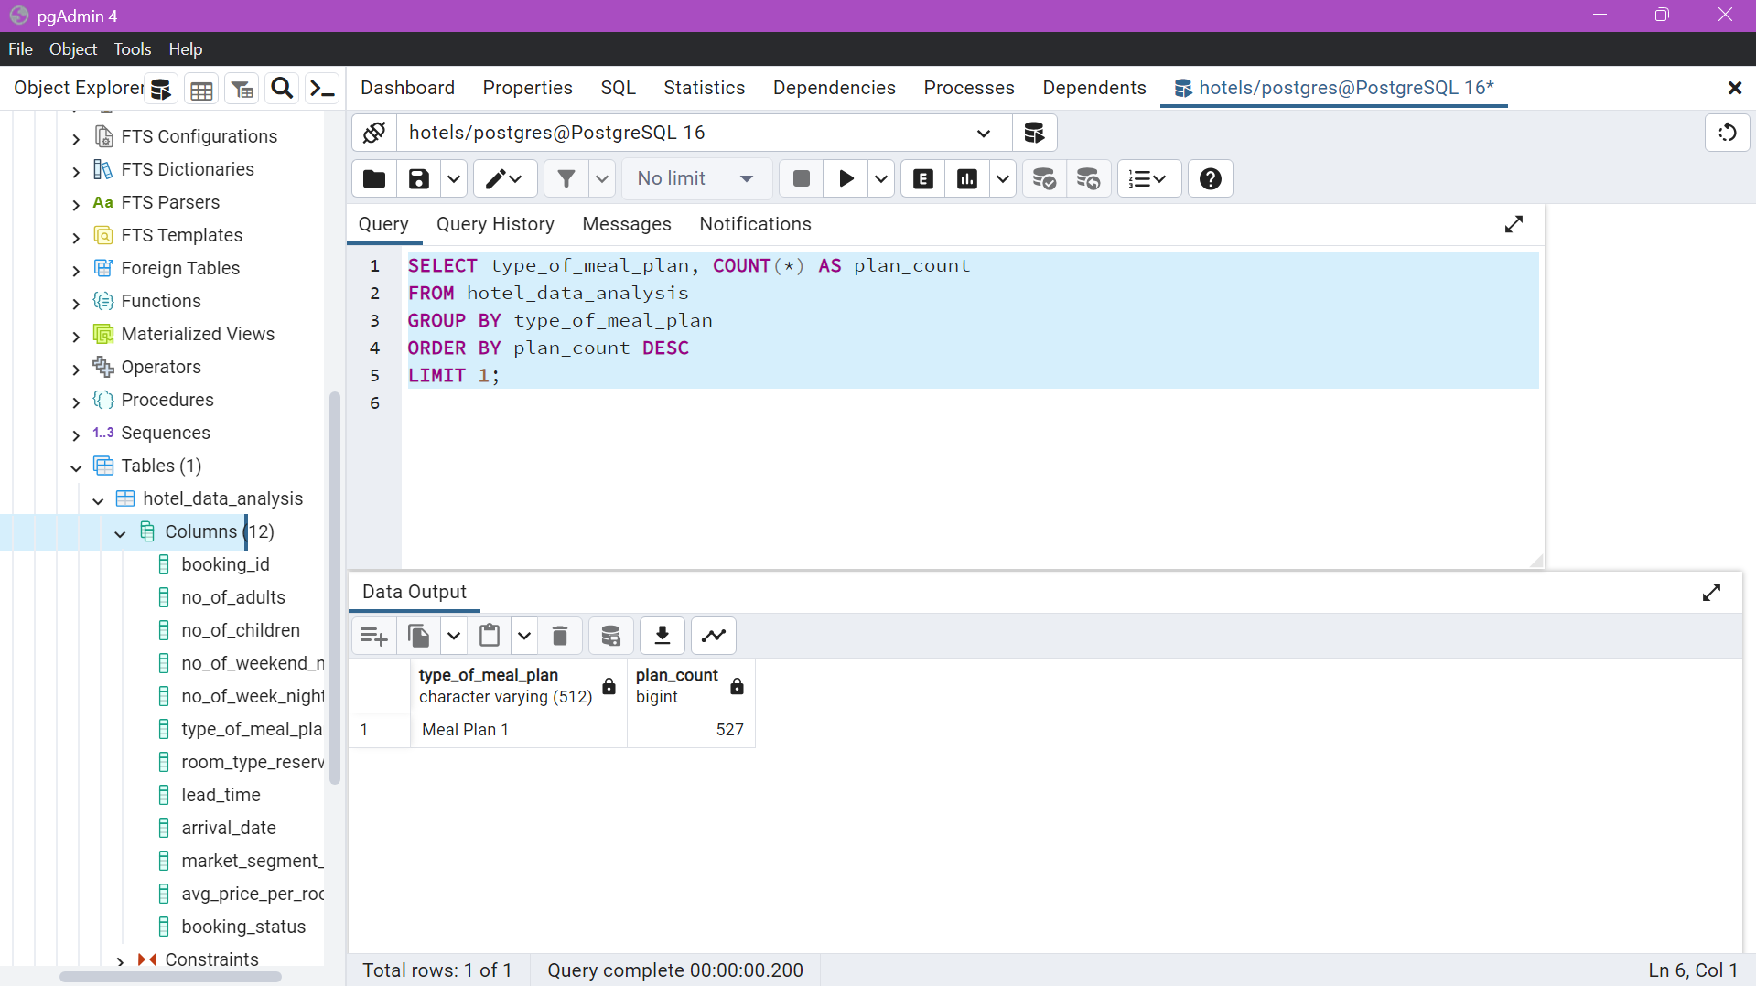
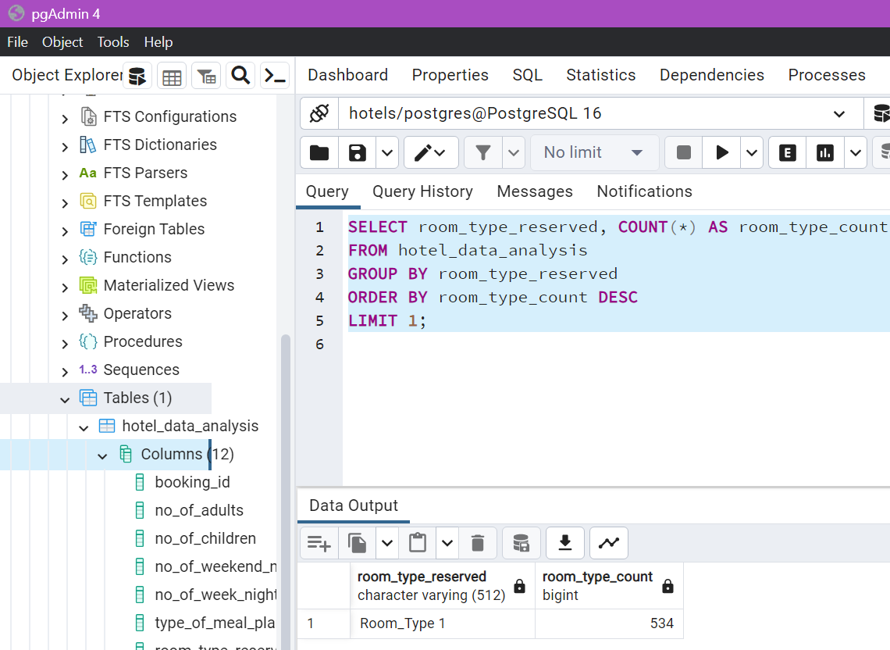
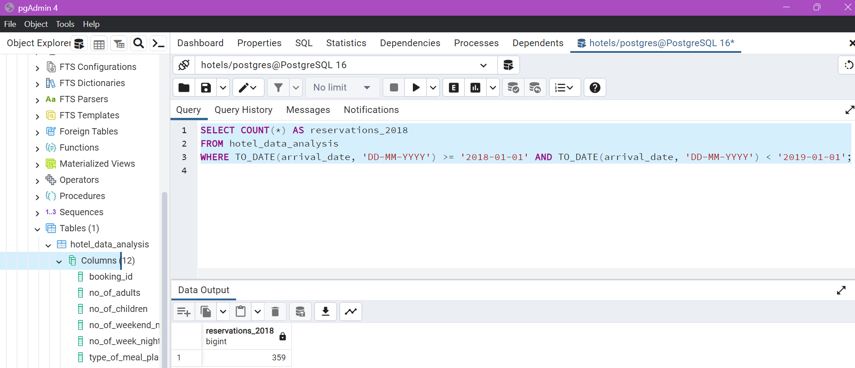

Source code using PostgreSQL
Total Reservations
Meal Plan
Common Room Reserved
Reservation made in the year 2018.

Slide 9
Interpretation of Results
Detailed Hotel Reservation Analysis
Total Reservations: A robust figure of 700 bookings indicates strong
market demand.
Meal Plan: Popular meal plan among guest is Meal Plan 1, with the highest count of 527.
Common Room Reserved: The most commonly used reserved room type is Room_Type 1 with the highest count of 534.
Reservation made in the Year 2018: A notable 359 reservations were made within the range of 1 January, 2018 – 31 December,2018.

Slide 10



Recommendations
Boost Direct Bookings: Create loyalty programs and special offers to get more direct bookings.
Improve Cancellation Policies: Change booking policies to lower cancellations.
Expand Online Reach: Use online travel agents and operators to get more bookings.
Increase Guest Loyalty: Start programs that give benefits to guests who come back.
Adjust Promotions for Seasons: Make marketing plans for busy and slow times to keep rooms filled.
Adjust Prices Smartly: Change prices based on demand using data from average daily rates.
Use Lead Time: Have deals for people who book early and make booking more flexible.

Slide 11


